Slide 1

Deep Audiobook Tuner: Background Music generation for audiobooks based on predicted sentiments.
St. Francis Institute of Technology
Department of Computer Engineering
7/22/2020

Slide 2
Group Members
Name | Roll No.
Daniel Lobo | 07
Jenny Dcruz | 16
Smita Deulkar | 19
Leander Fernandes | 20
Deep Audiobook Tuner 22-07-2020

Slide 3
Content
Introduction
Literature Review
Problem definition and Proposed solution
Conclusion
References
Deep Audiobook Tuner 22-07-2020

Slide 4
Introduction
Musical scores are a vital part of any form of entertainment.
There has been major advancements in music generation using artificial intelligence.
Audio books are preferred over reading books. Most audiobooks do not include background music due to issues of copyright infringements and licensing costs. Furthermore, it's not feasible to create musical scores for every audiobook.
At audiobook sites like Audible and LibriVox, these recordings number in the hundreds of thousands
Deep Audiobook Tuner 22-07-2020

Slide 5
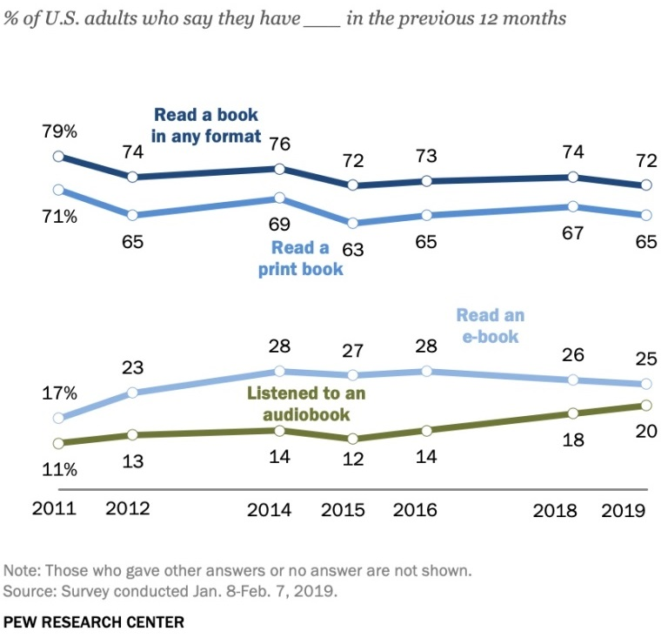
In 2013, users downloaded over 500 million hours of audiobooks from Audible alone, nearly 15% of Americans listened to an audiobook every month. As of 2019, this number has grown to 20% and shows a continuous growing trend.
Our project aims to create an easily accessible, efficient, and cost effective application to generate emotionally relevant musical scores for audio books.
Deep Audiobook Tuner 22-07-2020

Slide 6
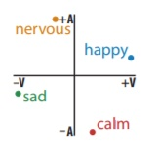
Literature Review
As cited in previous papers, a method was presented to extract sentiments from text where each word has a valence and an arousal value where the valence dimension indicates whether an emotion is positive or negative, whereas arousal indicates the intensity of the emotion.
This paper focused on four emotions, happy, nervous, sad, and calm, because they almost evenly span the circumplex. As shown in the inset, they set their coordinates to (.95, .31), (−.31, .95), (−.95, −.31), and (−.95, .31), respectively, an equal distribution near their original locations [1]
Deep Audiobook Tuner 22-07-2020

Slide 7
Different methods of generating music as observed from the papers we studied are using SeqGAN,and LSTMs and RNN. For example, Sang-gil Lee and his team, used SeqGAN to generate polyphonic music sequences.[2]
It was found that sentiment is perceived in music due to several features such as melody, harmony, tempo, timbre, etc. Quieter volume, slower tempo and lower pitch is found to convey the emotion of sadness whereas louder volume, faster tempo and higher pitch is perceived as happier. [3]
In another paper, a model was created which would generate music with a given sentiment using LSTMs and Logistic Regression.[4]
Deep Audiobook Tuner 22-07-2020

Slide 8
Problem definition
To develop a machine learning system that takes the scripts (audio and text) of an audio book as an input, analyzes the sentiments conveyed through the script and generates emotionally relevant music sequences.
As the emotions conveyed through the script vary, the model will smoothly adapt to the emotional changes and provide a musical score that compliments the audiobook.
Deep Audiobook Tuner 22-07-2020

Slide 9
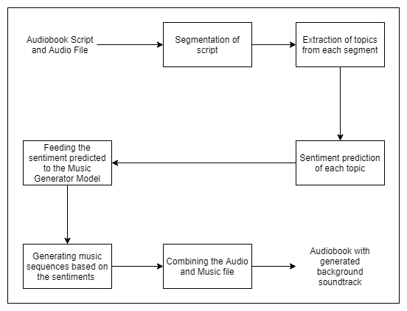
Proposed Solution
Deep Audiobook Tuner 22-07-2020

Slide 10
Algorithm
Our system consists of two models, sentiment analysis model and a music generation model.
The initial model with take an audio book file (script, audio) as it's input .
It will segment the script.
Individual segments are processed and topics are extracted from them.
The sentiment for each segment is analyzed from the clusters of topics extracted.
These sentiments are passed on as the input to the music generation model.
Deep Audiobook Tuner 22-07-2020

Slide 11
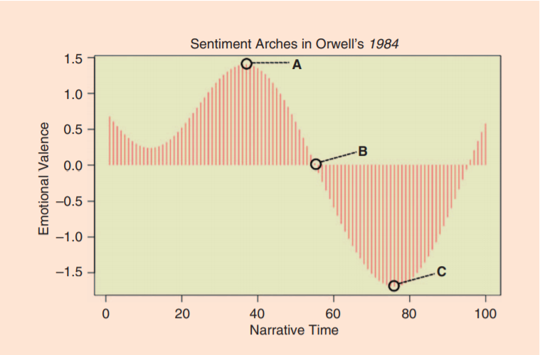
In the second model, music is generated and the sentiments are an important factor in adjusting the components of our model.
Sentiment is perceived in music due to several features such as melody, harmony, tempo, timbre, etc. Quieter volume, slower tempo and lower pitch is found to convey the emotion of sadness whereas louder volume, faster tempo and higher pitch is perceived as happier.
Deep Audiobook Tuner 22-07-2020

Slide 12
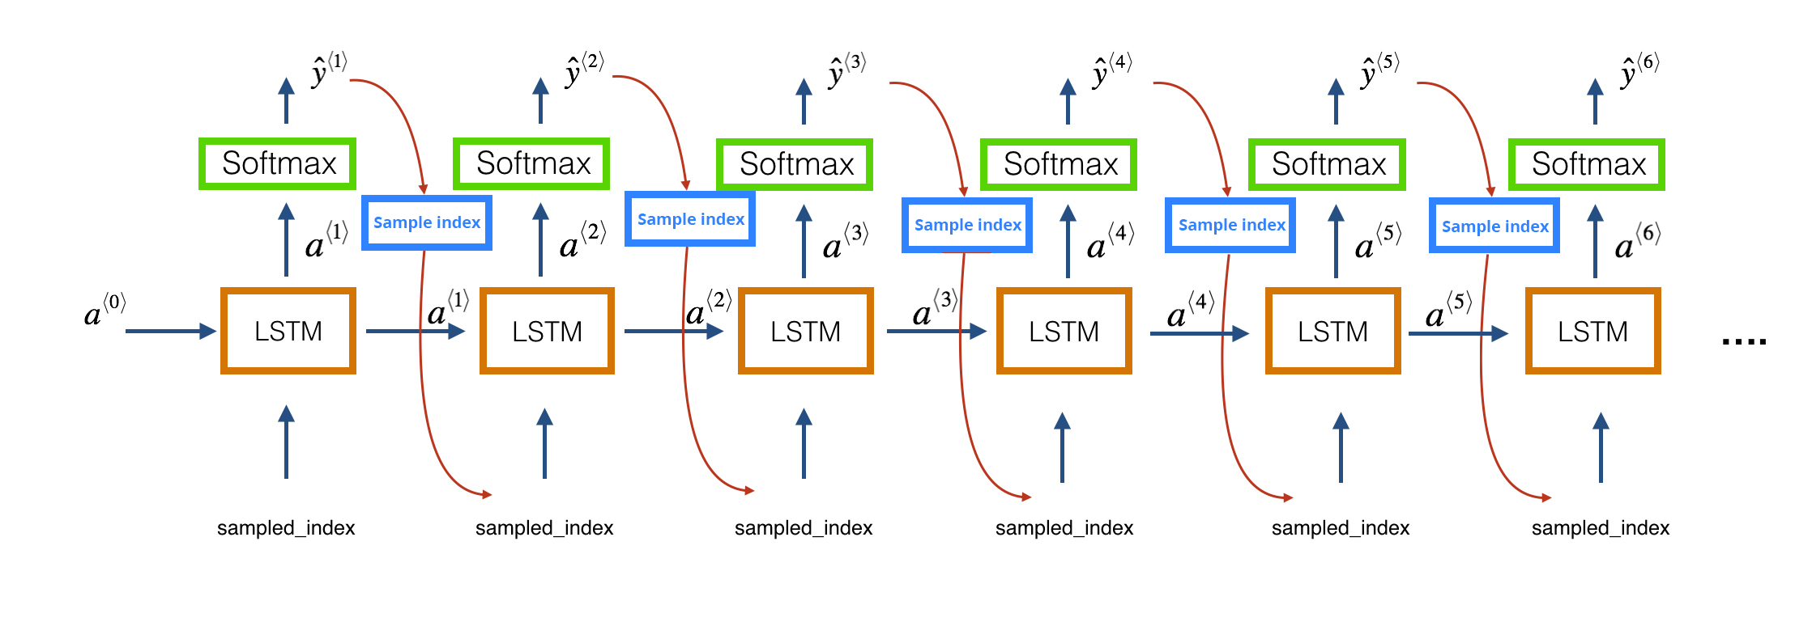
Using SeqGAN or LSTMs we can train a generative model that will use these components to adjust and generate musical segments with varying emotions.
Finally, the music file is combined with the audio file that gives us our output which is an audiobook with an emotionally relevant musical score.
Deep Audiobook Tuner 22-07-2020

Slide 13
Conclusion
High-quality narrations are integral to creating captivating digital content, but most audio books do not have background musical scores. The few that do have it are expensive as it a tedious task to create a soundtrack for it. Our proposed system can generate emotionally relevant scores which are cost effective, efficient and easily accessible to authors who want to add a soundtrack to their audiobook.
Deep Audiobook Tuner 22-07-2020

Slide 14
References
[1] Steve Rubin, Maneesh Agrawala “Generating Emotionally Relevant Musical Scores for Audio Stories”, University of California, Berkeley, 2014
[2] Sang-gil Lee, Uiwon Hwang, Seonwoo Min, and Sungroh Yoon “Polyphonic music generation with sequence generative adversarial networks” , Seoul National University, Seoul, Korea, 2018
[3] J. Salas, "Generating Music from Literature Using Topic Extraction and Sentiment Analysis" , in IEEE Potentials, vol. 37, no. 1, pp. 15-18, Jan.-Feb. 2018, doi: 10.1109/MPOT.2016.2550015.
[4] Lucas N. Ferreira, Jim Whitehead. “Learning to Generate Music With Sentiment”, 20th International Society for Music Information Retrieval Conference, Delft, The Netherlands, 2019
Deep Audiobook Tuner 22-07-2020

Slide 15
Thank you

